Slide 1
JUnit 5

Slide 2
JUnit 5
JUnit 5 is most widely used testing framework for java applications.
JUnit 5 aims to adapt java 8 style of coding and several other features as well

Slide 3
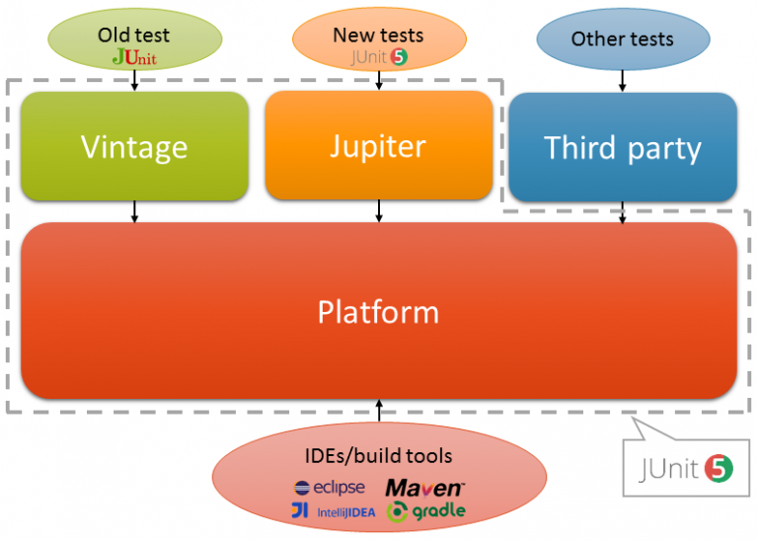
JUnit 5 Architecture
As compared to JUnit 4, JUnit 5 is composed of several different modules from three different sub-projects:
JUnit 5 = JUnit Platform + JUnit Jupiter + JUnit Vintage
JUnit Platform
JUnit Jupiter
JUnit Vintage

Slide 4
JUnit Platform
To be able to launch junit tests, IDEs, build tools or plugins need to include and extend platform APIs.
It defines the TestEngine API for developing new testing frameworks that runs on the platform.
It also provides a Console Launcher to launch the platform from the command line and build plugins for Gradle and Maven.

Slide 5
JUnit Jupiter
It includes new programming and extension models for writing tests.
It has all new junit annotations and TestEngine implementation to run tests written with these annotations.

Slide 6
JUnit Vintage
It primary purpose is to support running JUnit 3 and JUnit 4 written tests on the JUnit 5 platform.
It’s there for backward compatibility.

Slide 7
JUnit 5 Annotations
ANNOTATION | DESCRIPTION
@BeforeEach | The annotated method will be run before each test method in the test class.
@AfterEach | The annotated method will be run after each test method in the test class.
@BeforeAll | The annotated method will be run before all test methods in the test class. This method must be static.
@AfterAll | The annotated method will be run after all test methods in the test class. This method must be static.
@Test | It is used to mark a method as junit test

Slide 8
JUnit 5 Annotations
ANNOTATION | DESCRIPTION
@DisplayName | Used to provide any custom display name for a test class or test method
@Disable | It is used to disable or ignore a test class or method from test suite.
@Nested | Used to create nested test classes
@Tag | Mark test methods or test classes with tags for test discovering and filtering
@TestFactory | Mark a method is a test factory for dynamic tests

Slide 9
Test Suites
Using JUnit 5 test suites, you can run tests spread into multiple test classes and different packages. JUnit 5 provides two annotations: @SelectPackages and @SelectClasses to create test suites.
To execute the suite, you will use @RunWith(JUnitPlatform.class).
Additionally, you can use following annotations for filtering test packages, classes or even test methods.
@IncludePackages and @ExcludePackages to filter packages
@IncludeClassNamePatterns and @ExcludeClassNamePatterns to filter test classes
@IncludeTags and @ExcludeTags to filter test methods

Slide 10
Assertions
Assertions help in validating the expected output with actual output of a testcase.
To keep things simple, all JUnit Jupiter assertions are static methods in the org.junit.jupiter.Assertions class e.g. assertEquals(), assertNotEquals().

Slide 11
JUnit 5 Assertions
Assertions.assertEquals() and Assertions.assertNotEquals()
Assertions.assertArrayEquals()
Assertions.assertIterableEquals()
Assertions.assertLinesMatch()
Assertions.assertNotNull() and Assertions.assertNull()
Assertions.assertNotSame() and Assertions.assertSame()
Assertions.assertTimeout() and Assertions.assertTimeoutPreemptively()
Assertions.assertTrue() and Assertions.assertFalse()
Assertions.assertThrows()
Assertions.fail()

Slide 12
Assumptions
Assumptions class provides static methods to support conditional test execution based on assumptions.
A failed assumption results in a test being aborted.
Assumptions are typically used whenever it does not make sense to continue execution of a given test method.
In test report, these test will be marked as passed.
JUnit jupiter Assumptions class has two such methods: assumeFalse(), assumeTrue().

Slide 13
JUnit 5 Test LifeCycle
In JUnit 5, test lifecycle is driven by 4 primary annotations i.e. @BeforeAll, @BeforeEach, @AfterEach and @AfterAll.
Along with it, each test method must be marked with @Test annotation.
@Test annotation is virtually unchanged, although it no longer takes optional arguments.

Slide 14
Before And After
In junit test life cycle, you will primarily need to have some methods to setup and tear down the environment or test data on which the tests run.
In JUnit, for each test – a new instance of test is created.
@BeforeAll and @AfterAll annotations – clear by their name – should be called only once in entire tests execution cycle. So they must be declared static.
If their are multiple methods annotated with same annotation (e.g. two methods with @BeforeAll) then their execution order is undetermined.
@BeforeEach and @AfterEach are invoked for each instance of test so they need not to be static.

Slide 15
Test Order in JUnit 5
By default, JUnit runs tests using a deterministic, but unpredictable order (MethodSorters.DEFAULT).
In most cases, that behavior is perfectly fine and acceptable; but there're cases when we need to enforce a specific ordering.
In JUnit 5, we can use @TestMethodOrder and @Order annotations to run tests in order.

Slide 16
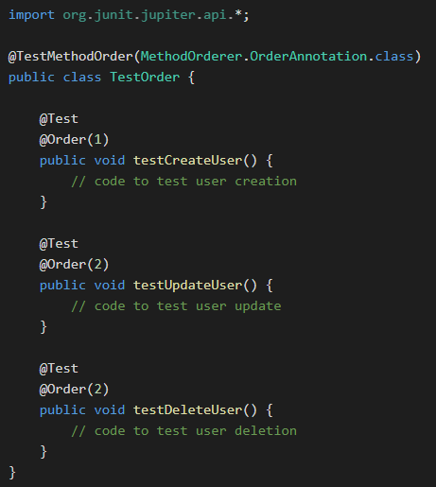
Test Order in JUnit 5

